Slide 1
Semantic Segmentation for Geophysical Data
Xiaoijn Tan, Eldad Haber

Slide 2
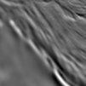

Motivation
Question addressed:
How to extract relevant geological information from geophysical data, leading to a geological unit map ?
Segmentation for Magnetic Data
Segmentation for Seismic Data
salt

Slide 3
Motivation
Question addressed:
How to extract relevant geological information from geophysical data, leading to a geological unit map ?
Segmentation for Magnetic Data
different magnetism
Different rocks
changes in the magnetic fields
changes in geological units

Slide 4
Motivation
Question addressed:
How to extract relevant geological information from geophysical data, leading to a geological unit map ?
Segmentation for Seismic Data
salt
different acoustic impedance
Different rocks
reflections of seismic waves at geologic interfaces
changes in geological units

Slide 5
Motivation
To date, segmentation for geophysical data is typically done manually
Limitations
Experienced geologists needed
Time and effort consumed
Done by Geologists

Slide 6
Motivation
Question addressed:
Can we borrow ideas from other fields to overcome these limitations?

Slide 7
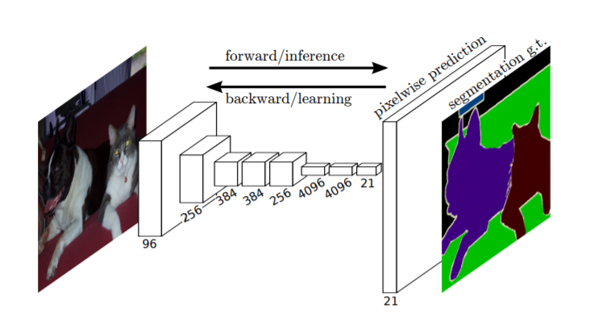
Motivation
Question addressed:
Can we borrow ideas from other fields to overcome these limitations? Yes! Use CNNs in semantic segmentation
Several probability maps
Natural images
cat
cat
Long, J., Shelhamer, E., & Darrell, T. (2015)

Slide 8
Motivation
Question addressed:
Can we borrow ideas from other fields to overcome these limitations? Yes! Use CNNs in semantic segmentation
Several probability maps
Pixel j
the likelihood of a pixel j belonging to each class
Long, J., Shelhamer, E., & Darrell, T. (2015)

Slide 9
Motivation
Question addressed:
Can we borrow ideas from other fields to overcome these limitations? Yes! Use CNNs in semantic segmentation
Several probability maps
Natural images
Advantages
automatically
no experience required
Fast, without effort.
Long, J., Shelhamer, E., & Darrell, T. (2015)

Slide 10
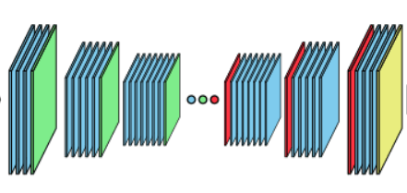
Basic ideas
attempting to use similar technology (CNNs) for geological segmentation
Geophysical images
Neural networks
Geological unit map

Slide 11
Challenges
Geophysical data vs. natural images
Data inconsistency
Data scarcity
Data complexity

Slide 12
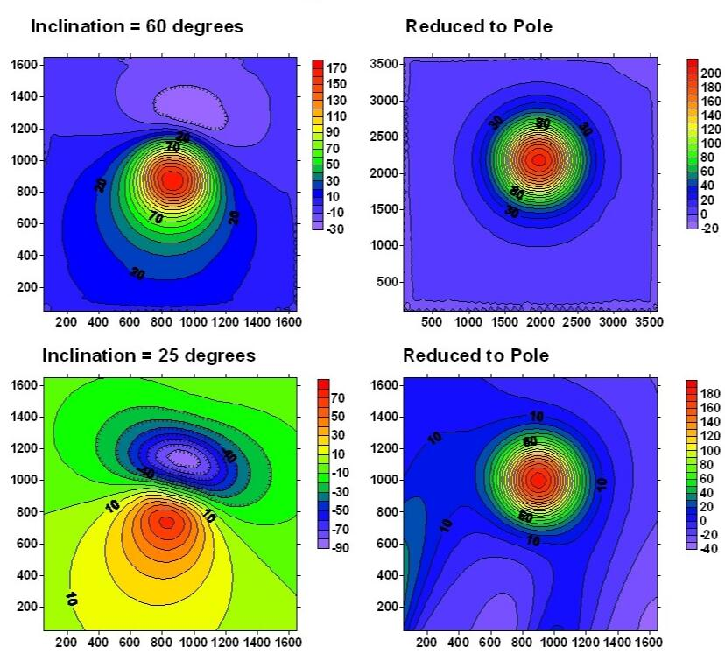
Challenges
different latitudes
data pre-processing
Geophysical data vs. natural images
Data inconsistency
e.g. Magnetic data measured at
different latitudes
http://hs.umt.edu/geosciences/faculty/sheriff/courses/439-applied-magnetics/default.php

Slide 13
Challenges
different latitudes
data pre-processing
Geophysical data vs. natural images
Data inconsistency
e.g. Magnetic data measured at
different latitudes
AI systems
confused by inconsistent data
leads to erroneous results
http://hs.umt.edu/geosciences/faculty/sheriff/courses/439-applied-magnetics/default.php

Slide 14
Challenges
different latitudes
data pre-processing
Geophysical data vs. natural images
Data inconsistency
e.g. Magnetic data measured at
different latitudes
AI systems
confused by inconsistent data
leads to erroneous results
Data pre-processing
http://hs.umt.edu/geosciences/faculty/sheriff/courses/439-applied-magnetics/default.php

Slide 15
Challenges
Geophysical data vs. natural images
Data inconsistency
Data scarcity
Data complexity
Data pre-processing

Slide 16
Challenges
Geophysical data vs. natural images
Data inconsistency
Data scarcity
Data complexity
Data pre-processing

Slide 17
Challenges
Data scarcity
E.g. magnetic data
Sufficient number
From geophysical surveys
Sufficient number
From computations
Insufficient number
require efforts by geologists

Slide 18
Challenges
Data scarcity
E.g. magnetic data
Insufficient number of pixel-wise labels for training
overfitting and poor generalization

Slide 19
Challenges
Data scarcity
E.g. magnetic data
Insufficient number of pixel-wise labels for training
overfitting and poor generalization
Data augmentation
Synthetically creating new samples from original training dataset

Slide 20
Challenges
Geophysical data vs. natural images
Data inconsistency
Data scarcity
Data complexity
Data pre-processing
Data augmentation

Slide 21
Challenges
Geophysical data vs. natural images
Data inconsistency
Data scarcity
Data complexity
Data pre-processing
Data augmentation

Slide 22
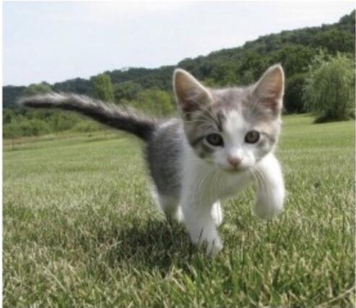
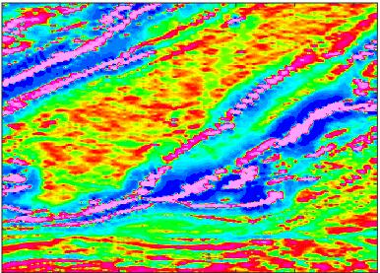
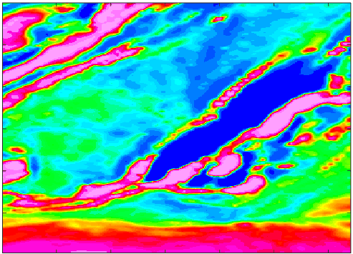
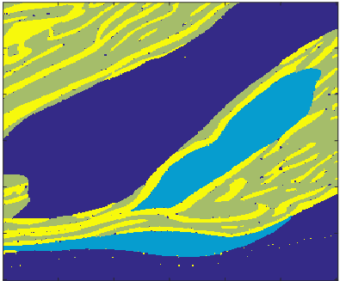
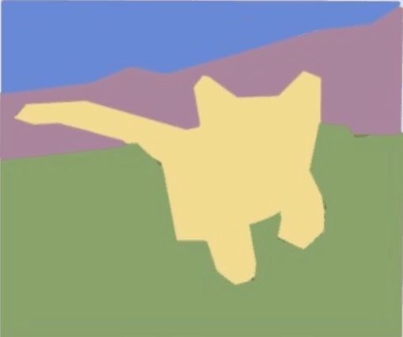
Challenges
Data complexity
more complex image-label relationship
Experienced geologists
Any schoolchild quite likely to know how to segment

Slide 23
Challenges
Geophysical data vs. natural images
Data inconsistency
Data scarcity
Data complexity
Data pre-processing
Data augmentation
New Neural Network architecture

Slide 24
Methods
Data pre-processing
Data augmentation
Supervised learning

Slide 25
Methods
Data pre-processing
Data augmentation
Supervised learning
Next will show how to implement these methods in magnetic data

Slide 26
Data pre-processing
different latitudes
data pre-processing
Data inconsistency
Magnetic data measured at
different latitudes
http://hs.umt.edu/geosciences/faculty/sheriff/courses/439-applied-magnetics/default.php

Slide 27
Data pre-processing
different latitudes
data pre-processing
Data inconsistency
Magnetic data measured at
different latitudes
Reduction to pole
Project magnetic data to a vertical plane
Put data into a similar frame of reference
http://hs.umt.edu/geosciences/faculty/sheriff/courses/439-applied-magnetics/default.php

Slide 28
Data pre-processing
TMI
1VD
Computing vertical derivatives
Both types of images are used by the AI system

Slide 29
Methods
Data pre-processing
Data augmentation
Supervised learning

Slide 30
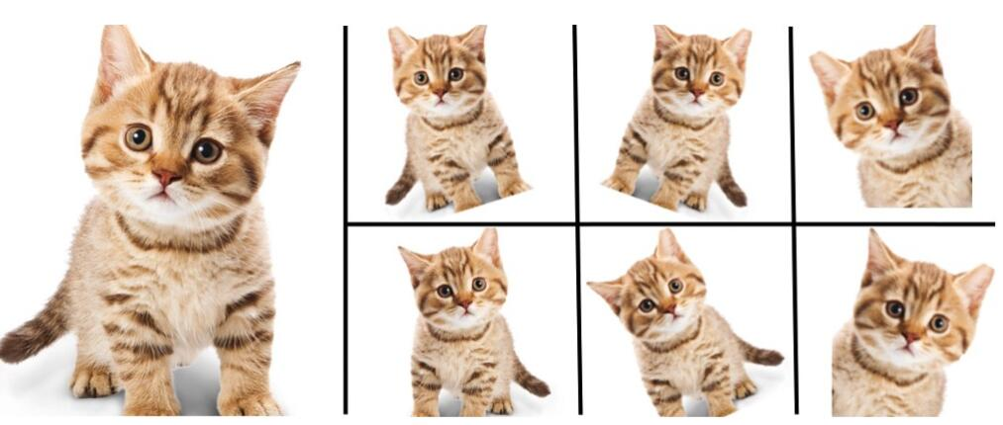
Traditional data augmentation
Traditional data augmentation
mirroring, random cropping, rotation, shearing and color shifting
fail to take the special characteristics of geophysical data into account
may be geologically infeasible
may ruin spatial continuity
Simply copy the original data
rotation
random cropping

Slide 31
Data augmentation
Question addressed:
How to synthesizing geologically feasible samples that share the same spatial continuity with the original data?
Geologically feasible
Same spatial continuity
Training images
Data augmentation

Slide 32
Data augmentation
Question addressed:
How to synthesizing geologically feasible samples that share the same spatial continuity with the original data?
Geologically feasible
Same spatial continuity
Training images
Data augmentation
Multi-point geostatistics

Slide 33
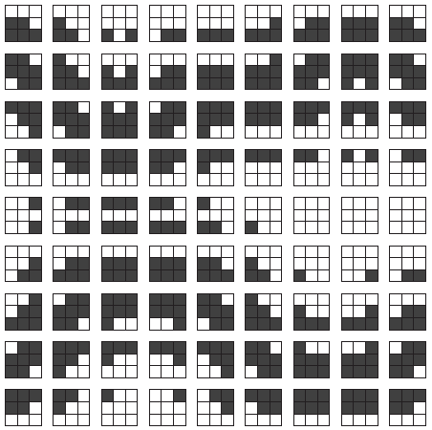
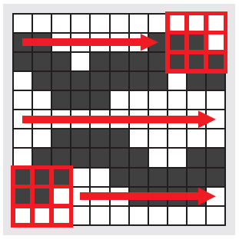
Basic idea
scanning
Arpat, G. B. (2004). SIMPAT: Stochastic Simulation with Patterns.
scanning the training images with a fixed template to extract a list of patches

Slide 34
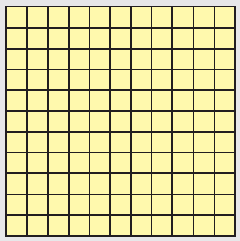
Basic idea
3
1
5
2
4
define a random path on the simulation grid
Empty simulation grid on which a realization is generated by sequentially visiting each node
Shows first 5 visiting nodes

Slide 35
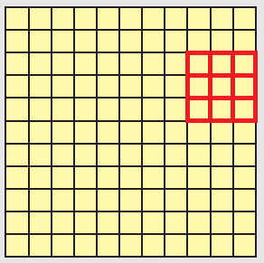
Basic idea
Visiting node 1
Arpat, G. B. (2004). SIMPAT: Stochastic Simulation with Patterns.

Slide 36
Basic idea
Uninformed data event
Visiting node 1

Slide 37
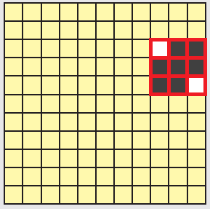
Basic idea
Uninformed data event
select a random
patch from the
patch database
Visiting node 1
compare
Arpat, G. B. (2004). SIMPAT: Stochastic Simulation with Patterns.

Slide 38
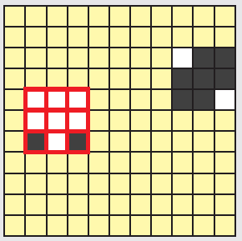
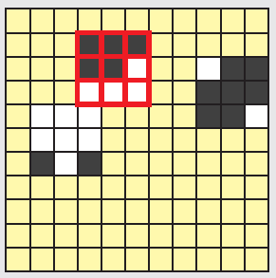
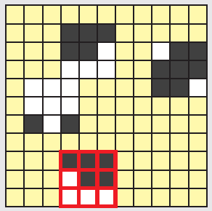
Basic idea
Uninformed data event
random
Randomly
select a patch
select a random
patch from the
patch database
Visiting node 1
random
Arpat, G. B. (2004). SIMPAT: Stochastic Simulation with Patterns.

Slide 39
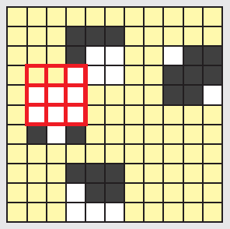
Basic idea
Uninformed data event
random
Randomly
select a patch
select a random
patch from the
patch database
Visiting node 1
random
informed data event
Visiting node 5
Arpat, G. B. (2004). SIMPAT: Stochastic Simulation with Patterns.

Slide 40
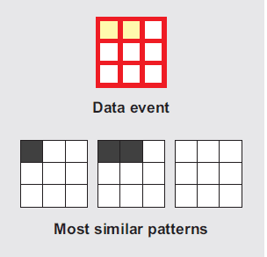
Basic idea
Uninformed data event
random
Randomly
select a patch
select a random
patch from the
patch database
Visiting node 1
random
informed data event
From patch database
compare
Similarity calculation needed
Visiting node 5
Arpat, G. B. (2004). SIMPAT: Stochastic Simulation with Patterns.

Slide 41
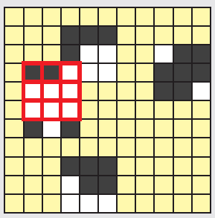
Basic idea
Uninformed data event
random
Randomly
select a patch
select a random
patch from the
patch database
Visiting node 1
random
informed data event
Randomly select one of the most similar patterns
paste it on to the realization
From patch database
compare
Similarity calculation needed
Visiting node 5
Arpat, G. B. (2004). SIMPAT: Stochastic Simulation with Patterns.

Slide 42
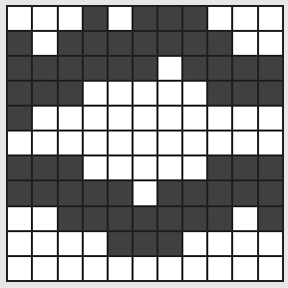
Basic idea
Visiting all the remaining nodes in this fashion, a final realization is obtained
Visiting all the remaining nodes
Final realization
Arpat, G. B. (2004). SIMPAT: Stochastic Simulation with Patterns.

Slide 43
Notes
Similarity calculation
Use concept of distance
Many different realizations can be generated by changing some parameters in MPS
Order of visiting nodes (random seed)
Size of the template
The idea of MPS used in data augmentation is much more complex than the basic idea shown above
Multivariate TI
Nonstationary TI:
Geological patterns tend to vary in space,
statistically different over the entire spatial domain

Slide 44
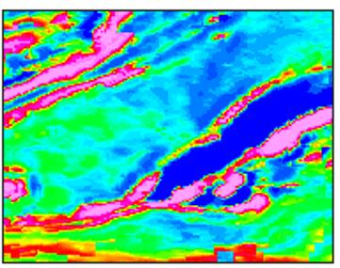
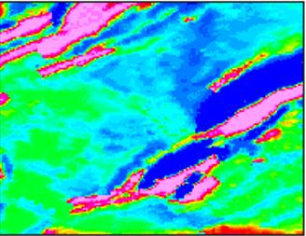
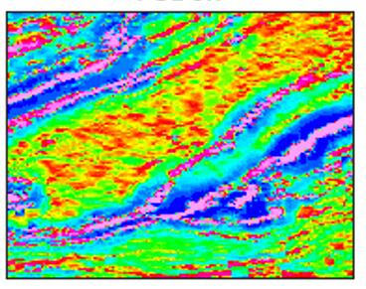
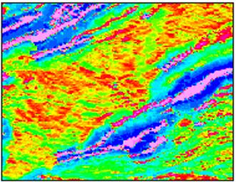
Traditional Multi-point geostatistics
Training image
Realization 1
Realization 2
Multiple-point statistics
Geologically feasible
Same spatial continuity

Slide 45
MPS Data augmentation
Different from traditional MPS
Not only simulate geophysical images,
but also simulate corresponding labels

Slide 46
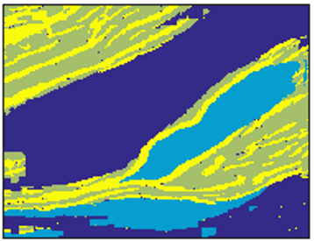
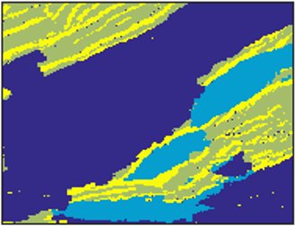
Data augmentation
Training image
Realization 1
Realization 2
Tune parameters
Order of visiting nodes
Size of template
Etc.
generate different realizations
Realization 1 more similar to TI
MPS

Slide 47
Methods
Data pre-processing
Data augmentation
Supervised learning using iCNN

Slide 48
iCNN
Why new NN architecture?
more complex image-label relationship
tried resnet , good for cat segmentation, but not good for geological segmentation
Experienced geologists
Done subjectively
Any schoolchild quite likely to know how to segment

Slide 49
Resnet vs. iCNN
Mathematical Viewpoint
Architectural Viewpoint

Slide 50
Resnet vs. iCNN
Mathematical Viewpoint
Architectural Viewpoint

Slide 51
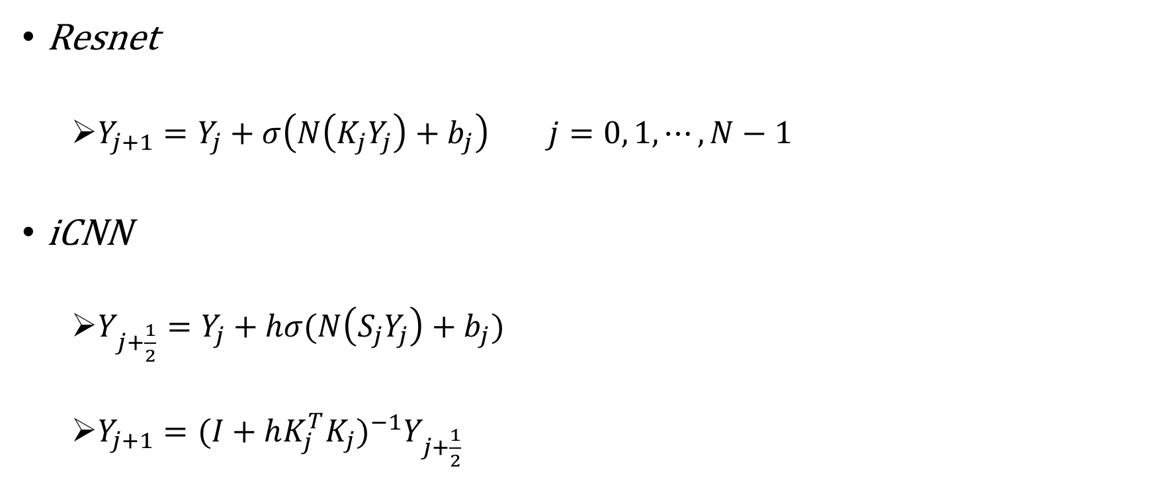
Resnet vs. iCNN
Resnet
$Y_{j+1}=Y_{j}+σ\left(N\left(K_{j}Y_{j}\right)+b_{j}\right) j=0, 1,⋯,N−1$
iCNN
$Y_{j+\frac{1}{2}}=Y_{j}+hσ(N\left(S_{j}Y_{j}\right)+b_{j})$
$Y_{j+1}={(I+hK_{j}^{T}K_{j})}^{−1}Y_{j+\frac{1}{2}}$

Slide 52
Resnet vs. iCNN
Resnet
$Y_{j+1}=Y_{j}+σ\left(N\left(K_{j}Y_{j}\right)+b_{j}\right) j=0, 1,⋯,N−1$
iCNN
$Y_{j+\frac{1}{2}}=Y_{j}+hσ(N\left(S_{j}Y_{j}\right)+b_{j})$
$Y_{j+1}={(I+hK_{j}^{T}K_{j})}^{−1}Y_{j+\frac{1}{2}}$
additional step
involve inverse matrix

Slide 53
Resnet vs. iCNN
Mathematical Viewpoint
Architectural Viewpoint

Slide 54
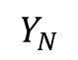
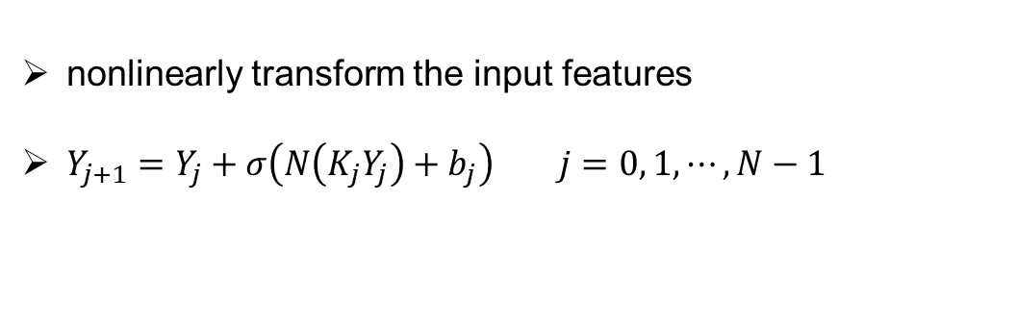


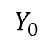
A typical building block of Resnet
nonlinearly transform the input features
$Y_{j+1}=Y_{j}+σ\left(N\left(K_{j}Y_{j}\right)+b_{j}\right) j=0, 1,⋯,N−1$
input
Channel 1
The output of
the forward propagation
conv
relu
conv
relu
Channel 2
…
$$Y_{N}$$
Channel 3
$$⋮$$
BN
BN
$$⋮$$
A building block
$$Y_{0}$$
(vector)

Slide 55
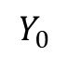
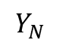
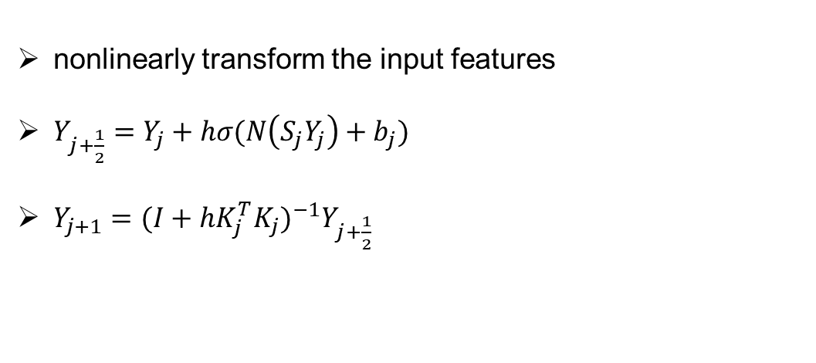
A typical building block of iCNN
nonlinearly transform the input features
$Y_{j+\frac{1}{2}}=Y_{j}+hσ(N\left(S_{j}Y_{j}\right)+b_{j})$
$Y_{j+1}={(I+hK_{j}^{T}K_{j})}^{−1}Y_{j+\frac{1}{2}}$
A building block
The output of
the forward propagation
input
conv
relu
inverse
conv
relu
inverse
…
$$Y_{N}$$
$$Y_{0}$$
BN
BN

Slide 56
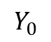
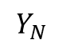
The output of
the forward propagation
input
conv
relu
conv
relu
…
$$Y_{N}$$
$$Y_{0}$$
BN
BN
A building block
The output of
the forward propagation
input
conv
relu
inverse
conv
relu
inverse
…
$$Y_{N}$$
$$Y_{0}$$
BN
BN

Slide 57
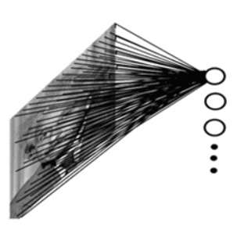
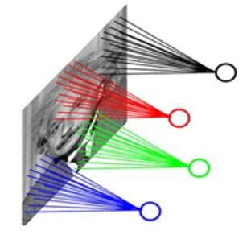
iCNN
Question addressed:
Why iCNN, not Resnet?
iCNN | Resnet
Inverse of convolution matrix | Convolution matrix

Slide 58
iCNN
Question addressed:
Why iCNN, not Resnet?
iCNN | Resnet
Inverse of convolution matrix | Convolution matrix
Large dense matrix | Large sparse matrix

Slide 59
iCNN
Question addressed:
Why iCNN, not Resnet?
iCNN | Resnet
Inverse of convolution matrix | Convolution matrix
Large dense matrix | Large sparse matrix
Globally connected | Locally connected

Slide 60
iCNN
Question addressed:
Why iCNN, not Resnet?
iCNN | Resnet
Inverse of convolution matrix | Convolution matrix
Large dense matrix | Large sparse matrix
Global connection | Local connection
Good for different scales contained in geological data

Slide 61
iCNN
Question addressed:
Why iCNN, not Resnet?
iCNN | Resnet
Inverse of convolution matrix | Convolution matrix
Large dense matrix | Large sparse matrix
Global connection | Local connection
Good for different scales
contained in geological data

Slide 62
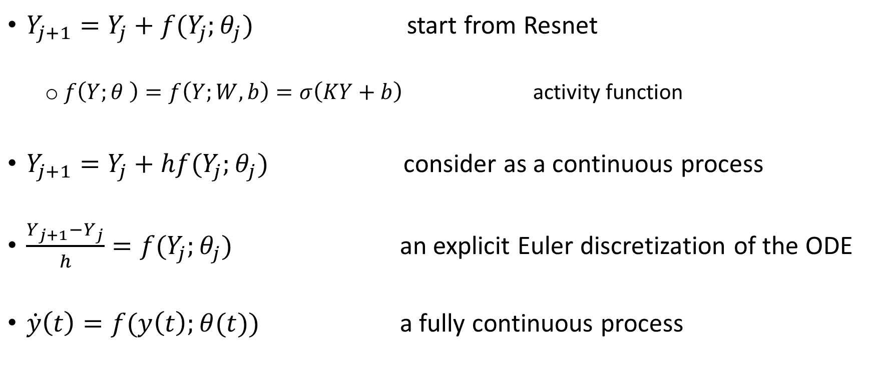
iCNN
Question addressed:
How to derive it?
$Y_{j+1}=Y_{j}+f(Y_{j};θ_{j})$ start from Resnet
$f\left(Y;θ \right)=f\left(Y;W,b\right)=σ\left(KY+b\right)$ activity function
$Y_{j+1}=Y_{j}+hf(Y_{j};θ_{j})$ consider as a continuous process
$\frac{Y_{j+1}−Y_{j}}{h}=f(Y_{j};θ_{j})$ an explicit Euler discretization of the ODE
$\dot{y}\left(t\right)=f(y\left(t\right);θ(t))$ a fully continuous process

Slide 63
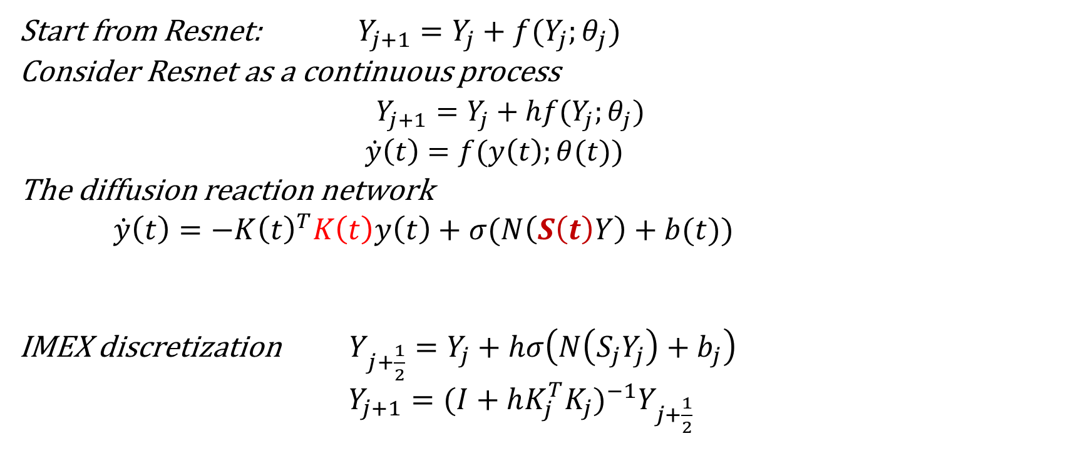
iCNN
How to derive it?
Start from Resnet: $Y_{j+1}=Y_{j}+f(Y_{j};θ_{j})$
Consider Resnet as a continuous process
$Y_{j+1}=Y_{j}+hf(Y_{j};θ_{j})$
$\dot{y}\left(t\right)=f(y\left(t\right);θ(t))$
The diffusion reaction network
$\dot{y}\left(t\right)=−K{\left(t\right)}^{T}K\left(t\right)y\left(t\right)+σ(N\left(S\left(t\right)Y\right)+b(t))$
IMEX discretization $Y_{j+\frac{1}{2}}=Y_{j}+hσ\left(N\left(S_{j}Y_{j}\right)+b_{j}\right)$
$Y_{j+1}={(I+hK_{j}^{T}K_{j})}^{−1}Y_{j+\frac{1}{2}}$
a diagonal convolution operator
1D convolution

Slide 64
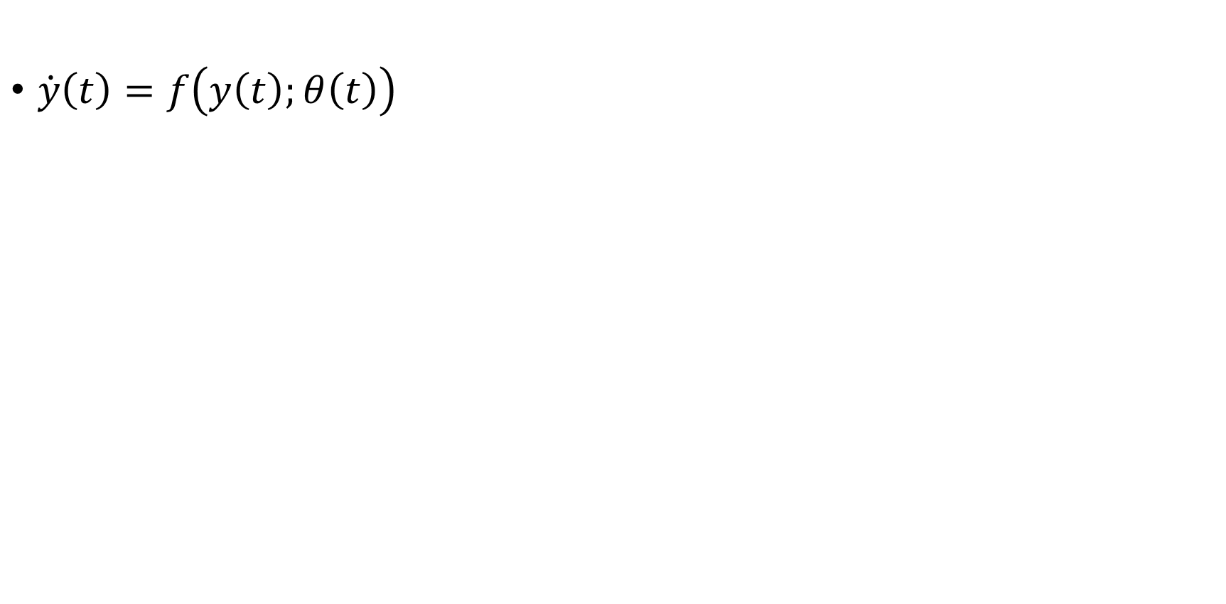
iCNN
$\dot{y}\left(t\right)=f\left(y\left(t\right);θ\left(t\right)\right)$

Slide 65
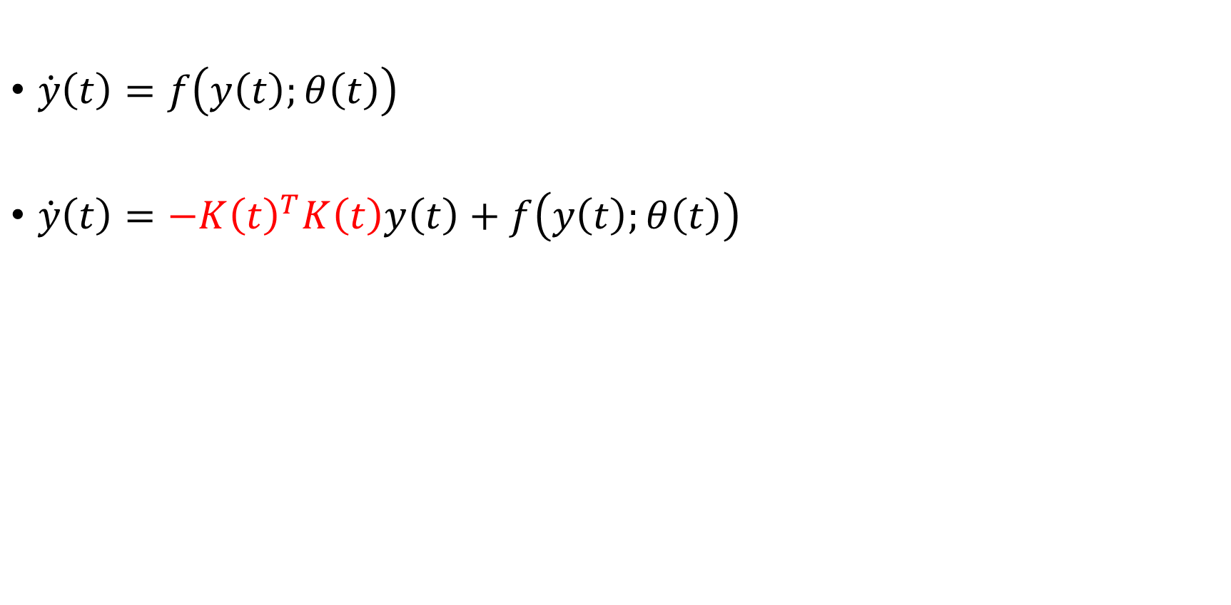
iCNN
$\dot{y}\left(t\right)=f\left(y\left(t\right);θ\left(t\right)\right)$
$\dot{y}\left(t\right)=−K{\left(t\right)}^{T}K\left(t\right)y\left(t\right)+f\left(y\left(t\right);θ\left(t\right)\right)$
Diffusion term
Stable
Diffuse, Globally connected

Slide 66
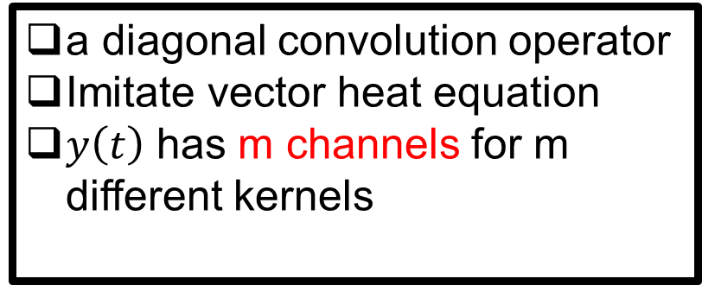
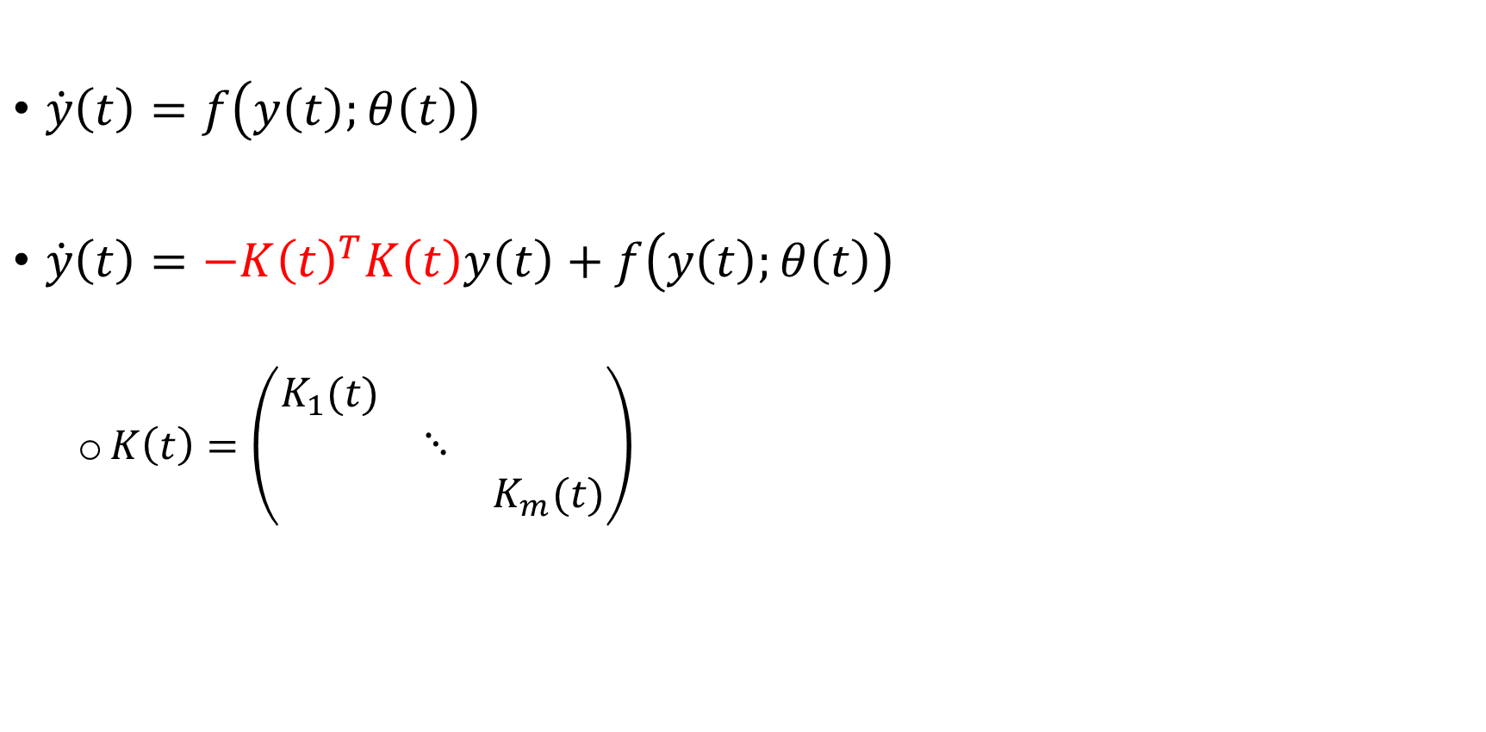
iCNN
$\dot{y}\left(t\right)=f\left(y\left(t\right);θ\left(t\right)\right)$
$\dot{y}\left(t\right)=−K{\left(t\right)}^{T}K\left(t\right)y\left(t\right)+f\left(y\left(t\right);θ\left(t\right)\right)$
$K\left(t\right)=\left(\begin{matrix}K_{1}(t) & & \\ & ⋱ & \\ & & K_{m}(t)\end{matrix}\right)$
Diffusion term
Stable
Diffuse, Globally connected
a diagonal convolution operator
Imitate vector heat equation
$y\left(t\right)$ has m channels for m different kernels

Slide 67
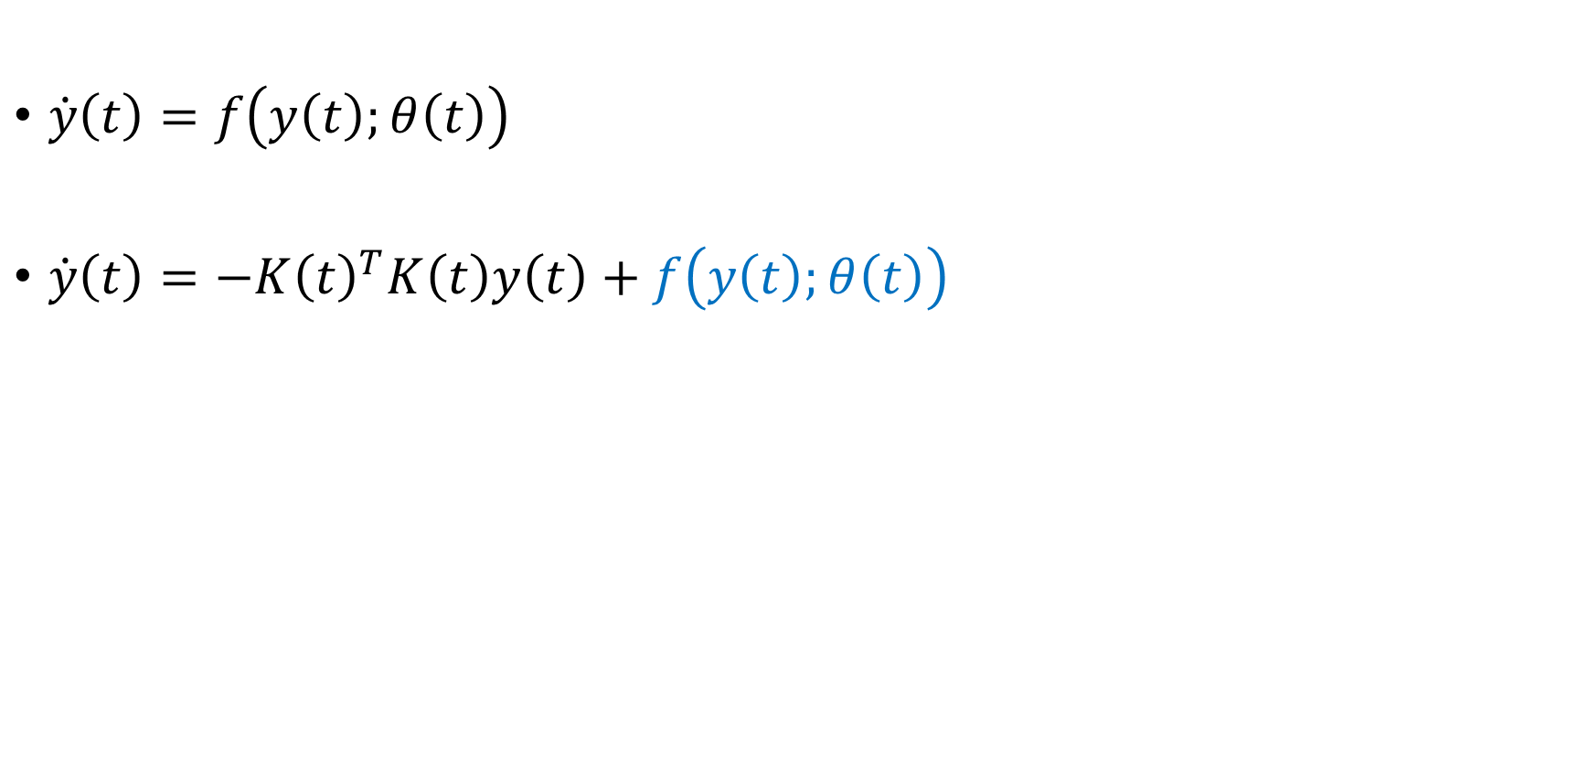
iCNN
$\dot{y}\left(t\right)=f\left(y\left(t\right);θ\left(t\right)\right)$
$\dot{y}\left(t\right)=−K{\left(t\right)}^{T}K\left(t\right)y\left(t\right)+f\left(y\left(t\right);θ\left(t\right)\right)$
Reaction term

Slide 68
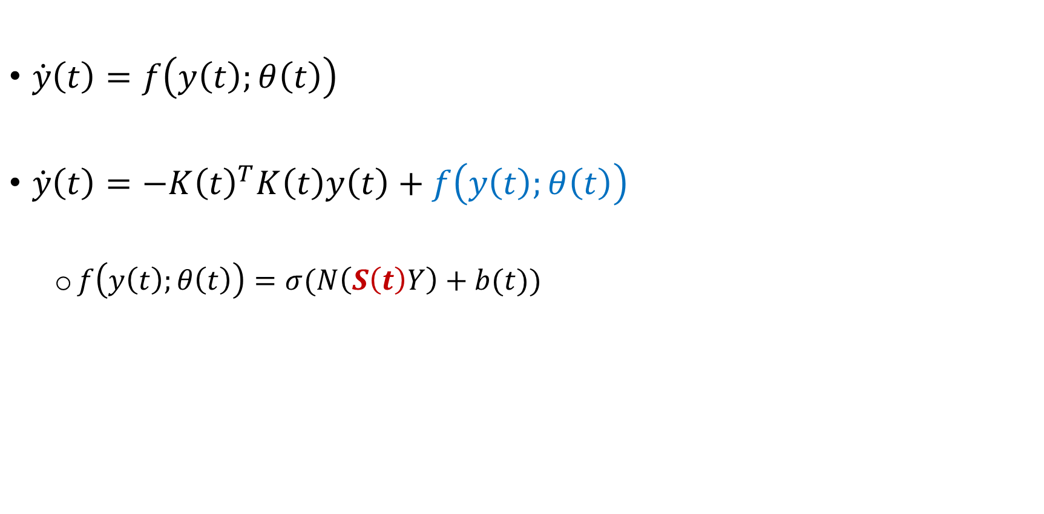
iCNN
$\dot{y}\left(t\right)=f\left(y\left(t\right);θ\left(t\right)\right)$
$\dot{y}\left(t\right)=−K{\left(t\right)}^{T}K\left(t\right)y\left(t\right)+f\left(y\left(t\right);θ\left(t\right)\right)$
$f\left(y\left(t\right);θ\left(t\right)\right)=σ(N\left(S\left(t\right)Y\right)+b(t))$
Reaction term
1D convolution
couples channels
not couple any pixels in space

Slide 69
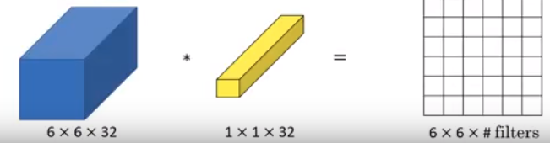
iCNN
$\dot{y}\left(t\right)=f\left(y\left(t\right);θ\left(t\right)\right)$
$\dot{y}\left(t\right)=−K{\left(t\right)}^{T}K\left(t\right)y\left(t\right)+f\left(y\left(t\right);θ\left(t\right)\right)$
$f\left(y\left(t\right);θ\left(t\right)\right)=σ(N\left(S\left(t\right)Y\right)+b(t))$
Reaction term
1D convolution
couples channels
not couple any pixels in space
channels
Y
S

Slide 70
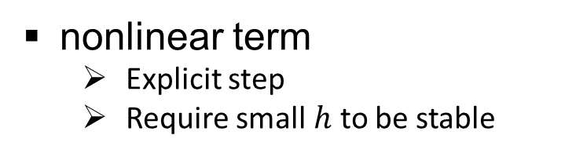
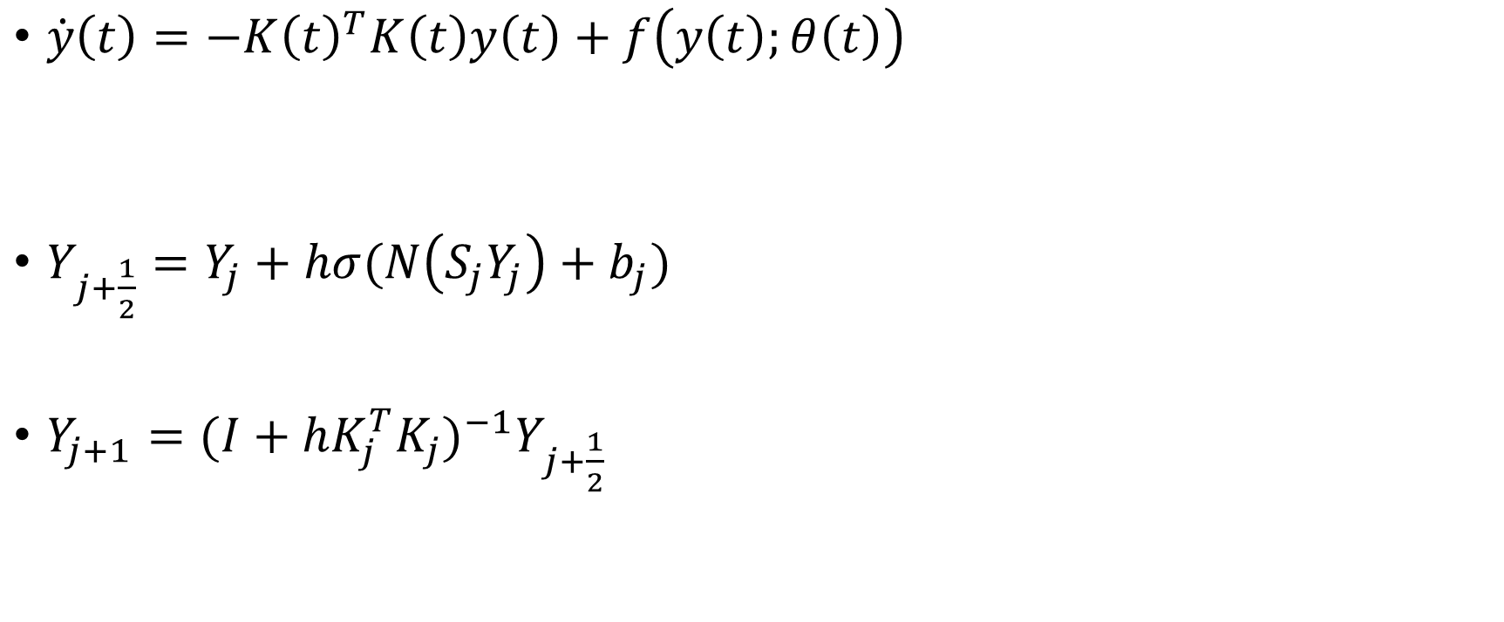
IMEX
linear term
decay fast
nonlinear term
decay slow
$\dot{y}\left(t\right)=−K{\left(t\right)}^{T}K\left(t\right)y\left(t\right)+f\left(y\left(t\right);θ\left(t\right)\right)$
$Y_{j+\frac{1}{2}}=Y_{j}+hσ(N\left(S_{j}Y_{j}\right)+b_{j})$
$Y_{j+1}={(I+hK_{j}^{T}K_{j})}^{−1}Y_{j+\frac{1}{2}}$
Discretization
Implicit Explicit schemes (IMEX)
nonlinear term
Explicit step
Require small $h$ to be stable
linear term
Implicit step
Non-local
Unconditional stable

Slide 71

Computation
${(I+hK_{j}^{T}K_{j})}^{−1}$
Involve inverse of a matrix
Impose periodic boundary condition on $K_{j}$
Block Circulant with Circulant Blocks (BCCB)
Decomposed as $K_{j}=F^{∗}Λ_{i}F$
2D unitary (DFT) matrix
diagonal matrix containing the eigenvalues of $K_{j}$

Slide 72

Computation
$K_{j}=F^{∗}Λ_{i}F$
$K_{j}^{T}K_{j}=F^{∗}\left(Λ_{j}^{∗}Λ_{j}\right)F$
${(hK^{T}K+I)}^{−1}=\left\{\begin{matrix}F^{∗}\left(\frac{1}{1+hΛ_{1}^{∗}Λ_{1}}\right)F & & \\ & ⋱ & \\ & & F^{∗}\left(\frac{1}{1+hΛ_{1}^{∗}Λ_{1}}\right)F\end{matrix}\right\}$
${(hK^{T}K+I)}^{−1}Y easy!$
Point-wise division

Slide 73

Computation
${(hK^{T}K+I)}^{−1}Y=\left\{\begin{matrix}F^{∗}\left(\frac{1}{1+hΛ_{1}^{∗}Λ_{1}}\right)F & & \\ & ⋱ & \\ & & F^{∗}\left(\frac{1}{1+hΛ_{1}^{∗}Λ_{1}}\right)F\end{matrix}\right\}Y$
Compute the FFT of the different channels of Y
Compute the FFT of the convolution matrix K (FK = $Λ$F)
Pointwise divide each channel by $1+hΛ_{1}^{∗}Λ_{1}$
Transform the result using the inverse FFT transform

Slide 74
Results

Slide 75

Study Area
TMI
shows large scale geologic features

Slide 76
Data pre-processing
computation of vertical derivatives
1VD
reveals detailed geologic features

Slide 77
Geological unit map
provided by an expert geologist

Slide 78
Data augmentation
Training image

Slide 79
Data augmentation
Training image
Realization 1
Realization 2
Geologically feasible
Same spatial continuity
MPS
Tune parameters
Order of visiting nodes
Size of template
Etc.
generate different realizations
Realization 1 more similar to TI

Slide 80
Randomly cropping
Training examples

Slide 81
64
64
Training dataset (3000)

Slide 82




Training
…
$$Y_{N}$$
$$training examples$$
Segmentation layer
$$Q$$
Tune parameters
To be as close as manual segmentation
Cross entropy
for each pixel
$$Q_{p}$$
softmax function
normalized exponential function
true segmentation
Predicted segmentation

Slide 83
A building block
The output of
the forward propagation
training
conv
relu
inverse
conv
relu
inverse
…
$$Y_{N}$$
$$training examples$$
BN
BN
Segmentation layer
$$Q$$
Tune parameters
To be as close as manual segmentation
Cross entropy
for each pixel
$$Q_{p}$$
softmax function
normalized exponential function
true segmentation
Predicted segmentation

Slide 84





Predicting
…
$$Y_{N}$$
Test examples
BN
BN
Segmentation layer
$$Q_{p}$$
softmax function
normalized exponential function
Predicted segmentation

Slide 85
predicting
…
$$Y_{N}$$
Test examples
BN
BN
Segmentation layer
$$Q_{p}$$
softmax function
normalized exponential function
Predicted segmentation

Slide 87

manual segmentation
automatically segmentation

Slide 88
manual segmentation
Test patches: 1VD
automatically segmentation
Test patches: TMI

Slide 89
1. Biased
manual segmentation
Long time
2. Noisy results
automatically segmentation
7 seconds for 200 examples

Slide 90
Summary
propose a solution to the problem of insufficient annotated magnetic data based on MPS
generated realizations are geologically realistic and share the similar spatial continuity with the original data
propose a new neural network architecture called iCNN to automatically segment magnetic data
our method is capable of superseding human segmentation in some aspects due to computational efficiency and its ability to identify the geological features

Slide 92
Thank you!

Slide 93
Show largest 12 classes!
Combine these 12 classes
Into 4 classes visually!
Class 1 (43.29%): 86, 88, 106, 65, 169
Class 2 (11.56%): 195
Class 3 (19.40%): 104, 94
(between channels)
Class 4 (11.26%): 168, 60, 182
(channels)
86: granodiorite (weak to moderate magnetic)
104: sediments (weak)
195: Tonalite (weak to moderate)
88: Walk lake intrusive complex (hightly magnetic)
94: volcaniclastic (weakly magnetic)
168 : Komatiite (strongly magnetic, important)
60 : Komatiite
106 ： like 86
65： like 86
182： slightly different 168 ： basalt （moderate to strong）
169： 104 sediments （weak to moderate）

Slide 94
Different from geophysical inversion?
geophysical inversion
Non-unique solution
Estimating models of physical property distributions based on geophysical survey data
Need physical laws to connect these quantities, e.g. Maxwell’s equations
Need discretization of PDE, sensitivity analysis and optimization
Not easy
Machine learning
Do not need explicit equations
Learn the relations directly

Slide 95
How to reduce to pole?
magnetic inclination is the angle made with the horizontal by the Earth's magnetic field lines
60º
reduction to pole
20º
S
N
S
N
projects the magnetic data to a vertical plane

Slide 96
Note
Magnetic field
Vector field
Intensity and direction
the response of a single magnetic cylinder
buried in a non-magnetic background
at two latitudes

Slide 97
How to deal with magnetic data obtained from different height?
Different resolution
To obtain similar resolution we use the process of analytical continuation
Upward continuation
Downward continuation
uses the magnetic potential in order to transfer the data recorded at one height to a different one

Slide 98





How to deal with magnetic data obtained from different height?
B: dipole
Start from a magnetic map i.e., f(x,y)
Measure the two x and y second derivatives everywhere on the map
From Laplace’s equation find the z second derivative, everywhere on the map
Using the second derivative, extrapolate the current map to a new elevation
$$∇∙B=0$$
$$∇∙B=∇∙(−∇U)=0$$
$$∇^{2}U=0$$

Slide 99


How to compute 1VD from magnetic field vector
The magnetic total field is the magnitude, or absolute value, of the magnetic field vector.
M: magnetic field vector
Total horizontal derivative (THDR): Measures the lateral rate of change of the measured field.

Slide 100

Generative approach vs. discriminative approach
Our method belongs to discriminative approach
Generative approach
Should know how the data might have been generated
But real data is almost always generated from much more complex processes
Rock type 2
Rock type 1
The shape for the same rock type is not that simple
Not good for segmentation using generative approach to generate new data?
Rock type 3

Slide 101

U-net
based on the fully convolutional network
consists of
a contracting path
the spatial information is reduced
while feature information is increased
an expansive path
combines the feature and
spatial information through
a sequence of up-convolutions and
concatenations with high-resolution
features from the contracting path
gives it the u-shaped architecture
change the resolution of the network and combine the different resolution together
has to be tuned carefully in order to classify objects at di erent scales.

Slide 102
Pattern formation
Stable uniform state in a kinetic system can become unstable when you add diffusion
Diffusion driven pattern formation

Slide 103

geostatistics
Nonstationary distance
account for not only the similarity between the data events, but also the spatial distance between them

Slide 104
Cropped area
Too many classes!

Slide 105
Show largest 12 classes!
Combine these 12 classes
Into 4 classes visually!
Class 1 (43.29%): 86, 88, 106, 65, 169
Class 2 (11.56%): 195
Class 3 (19.40%): 104, 94
(between channels)
Class 4 (11.26%): 168, 60, 182
(channels)
86: granodiorite (weak to moderate magnetic)
104: sediments (weak)
195: Tonalite (weak to moderate)
88: Walk lake intrusive complex (hightly magnetic)
94: volcaniclastic (weakly magnetic)
168 : Komatiite (strongly magnetic, important)
60 : Komatiite
106 ： like 86
65： like 86
182： slightly different 168 ： basalt （moderate to strong）
169： 104 sediments （weak to moderate）

Slide 107
Note

Slide 108
# layers = 2 + smoothing layer
# channels in last layer = 32
Validation Accuracy = 87.34%

Slide 110
# layers = 2 + smoothing layer
# channels in last layer = 32
Validation Accuracy = 87.34%

Slide 111
Results

Slide 113

Diffusion-Reaction equation
$\dot{y}\left(t\right)=f(y\left(t\right);θ(t))$
$\dot{y}\left(t\right)=−K{\left(t\right)}^{T}K\left(t\right)y\left(t\right)+f\left(y\left(t\right);θ\left(t\right)\right)$
$K\left(t\right)=\left(\begin{matrix}K_{1}(t) & & \\ & ⋱ & \\ & & K_{m}(t)\end{matrix}\right)$
$f\left(y\left(t\right);θ\left(t\right)\right)=σ(N\left(S\left(t\right)Y\right)+b(t))$
Diffusion term
Stable
Diffuse, Globally connected
Reaction term
a diagonal convolution operator
Imitate heat equations
1D convolution
couples channels
not couple any pixels in space

Slide 114






Segmentation layer of iCNN
A building block
The output of
the forward propagation
input
conv
relu
inverse
conv
relu
inverse
…
$$Y_{N}$$
$$Y_{0}$$
BN
BN
Segmentation layer
$$Q_{p}$$
softmax function
normalized exponential function
Predicted segmentation
$$Q_{p}\left(θ,W\right)=\exp\left(WY_{N}(θ)\right)diag(\frac{1}{e^{T}exp⁡(WY_{N}(θ))})$$

Slide 115






A similarity measure: cross entropy
A building block
The output of
the forward propagation
input
conv
relu
inverse
conv
relu
inverse
…
$$Y_{N}$$
$$Y_{0}$$
BN
BN
Segmentation layer
$$Q$$
$$Q_{p}$$
Cross entropy
for each pixel
softmax function
normalized exponential function
true segmentation
Predicted segmentation
$$Q_{p}\left(θ,W\right)=\exp\left(WY_{N}(θ)\right)diag(\frac{1}{e^{T}exp⁡(WY_{N}(θ))})$$
$$J\left(Q_{p},Q;θ,W\right)=−trace(Q^{T}logQ_{p}(θ,W))$$

Slide 116






Problem setup
…
$$Y_{N}$$
$$Y_{0}$$
BN
BN
Segmentation layer
$$Q$$
$$Q_{p}$$
Cross entropy
for each pixel
softmax function
normalized exponential function
true segmentation
Predicted segmentation
$$Q_{p}\left(θ,W\right)=\exp\left(WY_{N}(θ)\right)diag(\frac{1}{e^{T}exp⁡(WY_{N}(θ))})$$
$$J\left(Q_{p},Q;θ,W\right)=−trace(Q^{T}logQ_{p}(θ,W))$$
$$\min_{θ,W}{\frac{1}{s}\sum_{i=1}^{s}{J\left(Q_{p}^{(i)},Q^{(i)};θ,W\right)+αR(θ,W)}}$$
Given $\left\{\left(Y_{0}^{(i)},Q^{(i)}\right); i=1,⋯,S\right\}$ ,
Regularization term

Slide 118

Problem setup
Optimization problem
S training examples
$\left\{\left(Y_{0}^{(i)},Q^{(i)}\right); i=1,⋯,S\right\}$
$\min_{θ,W}{\frac{1}{s}\sum_{i=1}^{s}{J\left(Q_{p}^{(i)},Q^{(i)};θ,W\right)+αR(θ,W)}}$

Slide 120

Segmentation layer
$Q_{p}\left(θ,W\right)=\exp\left(WY_{N}\left(θ\right)\right)diag\left(\frac{1}{e^{T}\exp\left(WY_{N}\left(θ\right)\right)}\right)$
Softmax function
normalized exponential function

Slide 121

Problem setup
$Y_{s}=\left\{y_{1},⋯,y_{b}\right\}∈R^{dXb}$
$c=\left\{c_{1},⋯,c_{b}\right\}∈L^{b}$ where $L=\left\{l_{1},⋯,l_{k}\right\}$
$\min_{θ,W}{\frac{1}{s}\sum_{i=1}^{s}{J\left(g\left(y^{(i)};θ\right),Q^{(i)};W\right)+αR(θ,W)}}$
$Q_{p}\left(θ,W\right)=\exp\left(Wg\left(y;θ\right)\right)diag(\frac{1}{e^{T}exp⁡(Wg(y;θ))})$
$J\left(Q,Q_{p};θ,W\right)=−trace(Q^{T}logQ_{p}(θ,W))$

Slide 122
Data pre-processing
different latitudes
data pre-processing
Data inconsistency
Magnetic data measured at
different latitudes
different heights
Reduction to pole
Project magnetic data to a vertical plane
Put data into a similar frame of reference
http://hs.umt.edu/geosciences/faculty/sheriff/courses/439-applied-magnetics/default.php

Slide 126
Challenges
Geophysical data vs. natural images
Data inconsistency
Data pre-processing
Data scarcity
Data augmentation
geostatistics
Data complexity
New neural network architecture
iCNN

Slide 127
iCNN
Based on a residual network (Resnet) that have favorite stability properties

Slide 128


iCNN
nonlinearly transform the input features
a double layer of the form
$Y_{j+1}=Y_{j}−K_{j}^{T}σ\left(N\left(K_{j}Y_{j}\right)+b_{j}\right) j=0, 1,⋯,N−1$
The output of
the forward propagation
input
conv
relu
conv
relu
…
$$Y_{N}$$
$$Y_{0}$$
BN
BN
conv
A building block

Slide 129
A typical building block of Resnet
nonlinearly transform the input features
a double layer of the form
$Y_{j+1}=Y_{j}−K_{j}^{T}σ\left(N\left(K_{j}Y_{j}\right)+b_{j}\right) j=0, 1,⋯,N−1$
The output of
the forward propagation
input
conv
relu
conv
relu
…
$$Y_{N}$$
$$Y_{0}$$
BN
conv
BN
conv
A building block

Slide 130
iCNN

Slide 131

iCNN
$Y_{j+\frac{1}{2}}=Y_{j}+hσ(N\left(S_{j}Y_{j}\right)+b_{j})$
$Y_{j+1}={(I+hK_{j}^{T}K_{j})}^{−1}Y_{j+\frac{1}{2}}$

Slide 132

Resnet
$Y_{j+1}=Y_{j}+f(Y_{j};θ_{j})$
$f\left(Y;θ \right)=f\left(Y;W,b\right)=σ\left(KY+b\right)$
$Y_{j+1}=Y_{j}+hf(Y_{j};θ_{j})$
$\frac{Y_{j+1}−Y_{j}}{h}=f(Y_{j};θ_{j})$

Slide 133

Forward propagation
$K_{j}=F^{∗}Λ_{i}F$
$K_{j}^{T}K_{j}=F^{∗}\left(Λ_{j}^{∗}Λ_{j}\right)F$
${(hK^{T}K+I)}^{−1}=\left\{\begin{matrix}F^{∗}\left(\frac{1}{1+hΛ_{1}^{∗}Λ_{1}}\right)F & & \\ & ⋱ & \\ & & F^{∗}\left(\frac{1}{1+hΛ_{1}^{∗}Λ_{1}}\right)F\end{matrix}\right\}$

Slide 134

Problem setup
$Y_{s}=\left\{y_{1},⋯,y_{b}\right\}∈R^{dXb}$
$c=\left\{c_{1},⋯,c_{b}\right\}∈L^{b}$ where $L=\left\{l_{1},⋯,l_{k}\right\}$
$\min_{θ,W}{\frac{1}{s}\sum_{i=1}^{s}{J\left(g\left(y^{(i)};θ\right),Q^{(i)};W\right)+αR(θ,W)}}$
$Q_{p}\left(θ,W\right)=\exp\left(Wg\left(y;θ\right)\right)diag(\frac{1}{e^{T}exp⁡(Wg(y;θ))})$

Slide 135
IMEX

Slide 136

Resnet
$Y_{j+1}=Y_{j}+f(Y_{j};θ_{j})$
$f\left(Y;θ \right)=f\left(Y;W,b\right)=σ\left(KY+b\right)$
$Y_{j+1}=Y_{j}+hf(Y_{j};θ_{j})$
$\frac{Y_{j+1}−Y_{j}}{h}=f(Y_{j};θ_{j})$
$\dot{y}\left(t\right)=f(y\left(t\right);θ(t))$

Slide 138

iCNN
$\dot{y}\left(t\right)=f\left(y\left(t\right);θ\left(t\right)\right)$
Relate Exploding and Vanishing Gradients to the stability criteria of ODEs and its discrete counterpart

Slide 140
Need to modify the slides below!

Slide 141
iCNN
Forward propagation
nonlinearly transform the input features
Segmentation layer
Formulate the learning problem

Slide 142

Forward propagation
Based on Resnet with favorite stability properties
$Y_{j+1}=Y_{j}+hf(Y_{j},θ_{j})$
$θ=\left\{K,b\right\}$
$f$is a double layer of the form
$f\left(Y,θ\right)=−K^{T}σ(N(KY)+b)$ where $N\left(Z\right)=\frac{Z}{\sqrt{\sum_{j}{z_{j}^{2}+∈}}}$

Slide 143

Forward propagation
$Y_{t}=−{K\left(t\right)}^{T}σ(N\left(K\left(t\right)Y\right)+b(t))$
$Y_{t}=−{K\left(t\right)}^{T}K\left(t\right)Y+σ(N\left(S\left(t\right)Y\right)+b(t))$
$K\left(t\right)=\left(\begin{matrix}K_{1}(t) & & \\ & ⋱ & \\ & & K_{m}(t)\end{matrix}\right)$

Slide 144
Forward propagation
$Y_{j+\frac{1}{2}}=Y_{j}+hσ(N\left(S_{j}Y_{j}\right)+b_{j})$
$Y_{j+1}={(I+hK_{j}^{T}K_{j})}^{−1}Y_{j+\frac{1}{2}}$

Slide 145
Forward propagation
$K_{j}=F^{∗}Λ_{i}F$
$K_{j}^{T}K_{j}=F^{∗}\left(Λ_{j}^{∗}Λ_{j}\right)F$
${(hK^{T}K+I)}^{−1}=\left\{\begin{matrix}F^{∗}\left(\frac{1}{1+hΛ_{1}^{∗}Λ_{1}}\right)F & & \\ & ⋱ & \\ & & F^{∗}\left(\frac{1}{1+hΛ_{1}^{∗}Λ_{1}}\right)F\end{matrix}\right\}$

Slide 146
Segmentation layer

Slide 147
Problem setup
$Y_{s}=\left\{y_{1},⋯,y_{b}\right\}∈R^{dXb}$
$c=\left\{c_{1},⋯,c_{b}\right\}∈L^{b}$ where $L=\left\{l_{1},⋯,l_{k}\right\}$
$\min_{θ,W}{\frac{1}{s}\sum_{i=1}^{s}{J\left(g\left(y^{(i)};θ\right),Q^{(i)};W\right)+αR(θ,W)}}$
$Q_{p}\left(θ,W\right)=\exp\left(Wg\left(y;θ\right)\right)diag(\frac{1}{e^{T}exp⁡(Wg(y;θ))})$

Slide 148
Results

Slide 149
Training dataset

Slide 150
# layers = 2 + smoothing layer
# channels in last layer = 32
Validation Accuracy = 87.34%

Slide 151
Summary

Slide 152
Research timeline

Slide 153
Thank you!

Slide 156



Multi-point geostatistics
Training image
Realization 1
Realization 2
Multiple-point statistics
Geologically feasible
Same spatial continuity

Slide 157
Multi-point geostatistics
Training image
Realization 1
Realization 2
Multiple-point statistics

Slide 159
Challenges
Data scarcity
E.g. magnetic data
Sufficient number
From geophysical surveys
Sufficient number
From computations
Insufficient number
require efforts by geologists
Insufficient number of pixel-wise labels for training
overfitting and poor generalization

Slide 160
Data complexity

Slide 161
Basic ideas

Slide 162
Motivation
Often, people want to get information from geophysical data
Do geological interpretation
A key step of geological interpretation is segmentation of geophysical data
Defintion
Goal: for further geological study and get natural resources

Slide 163
Motivation
Geophysical data
collected from geophysical surveys
learn about different geological units and structural geology
Airborne magnetic data
Total Magnetic Intensity

Slide 164
Current Method
Currently, geologists do it manually
Disadvantages: time-consuming, subjective

Slide 165
Borrow methods from machine learning
This problem is similar to semantic segmentation
Definition
Often can be solved using CNN

Slide 166
Questions
Can we use similar technology to apply on geophysical data

Slide 167
Challenges
Data complexity
In semantic segmentation, we use natural images, e.g. the picture of a dog
Easy to segment
To segment geophysical data,
Need experienced geologists
Subjective: different one generate different results
An art more than a simple rule

Slide 168
Challenges
Data scarcity
For semantic segmentation of natural images, we have a lot benchmark datasets used for learning
Easy to generate pixel labels for natural images
For geophysical data, since generate geological map needs a lot of time and effort, we do not have many interpreted data for training
We use data augmentation to solve this issue and talk it in detail later

Slide 169
Challenges
Data inconsistency
For geophysical data, they usually record in different location and different latitude
Same objects have totally different TMI
Need to make them consistent for learning

Slide 170
solution
Propose a new method
Data pre-processing
Data augmentation
Training using NN

Slide 171
Data preprocessing
Why
Data recorded in different latitude and height
Same objects have different TMI, different resolution
Generate errors when predicting
Can not refer from a different resolution using AI
Reduction to pole
Same potential

Slide 172
Data Augmentation
Why
Not many interpreted geophysical data (time consuming) used for training
not enough for training
traditional data augmentation methods
Simply rotation, mirroring and etc.
They may suit natural images
Geophysical data have special nature, traditional methods will ruin this nature:

Slide 173
Data augmentation
Geophysical image usually has spatial continuity and heterogeneity, which will be ruined by traditional methods
Solution: to preserve these nature, we use geostatistics to generate new images, while make these new images share the same spatial continuity as the original one.

Slide 174
geostatistics
Goal:
Generate new realizations based on original training images.
principles:
Learn spatial statistics from the original training images
Use that spatial statistics to generate new realization
Details below

Slide 175
geostatistics
Learn spatial statistics from the original training images
Pixel-based method
How to estimate the nodal value in the realizations during simulation
Scan the training images
Get configuration of data events whose surrounding values are the same
Estimate the empirical distribution of central values
Patch-based method
Instead of estimating a single value, we paste a patch
Scan the training image to get a patch database
Compare data event in realization to each patch in the patch databased
Find the closest one to paste

Slide 176
geostatistics
Patch-based method
Instead of estimating a single value, we paste a patch
Scan the training image to get a patch database
Compare data event in realization to each patch in the patch databased
Find the closest one to paste
How to compare?
Use distance (dissimilarity)

Slide 177
distance
For continuous
For categorical
For multivariate
A combination of continuous distance and categorical distance
But there is a problem!

Slide 178
nonstationary
In patch-based method, we treat every patch equally. We assume the statistics here is similar to there
However, in real data, it is not the case.
When generating realizations, the realizations do not have the same spatial statistics as the original
How to solve?
We treat each patch unequally and associate the spatial coordinate with them

Slide 179
nonstationary
Nonstationary distance

Slide 180
Data augmentation
We can generate many new realizations (multivariate, nonstationary) used as training datasets

Slide 181
Training
We have training datasets
Want to learn a mapping function from training data to their pix-wise labels
This is an optimization problem, formulated as
Many optimization algorithm can be used to get a solution

Slide 182
Mapping function
We propose a new mapping function
iCNN
We will explain it how to get it from resnet

Slide 183
resnet
Y = y + sigma (KY + b)
Augment using h
Y = y + h*sigma(Ky+b)
View as ODE
Y_dot = sigma(Ky +b) when h is small
Use knowledge of ODE to explain gradient vanishing and exploding

Slide 184
Resnet with stable properties

Slide 186
Challenges
In semantic segmentation, we have a lot of

Slide 188
Background
Segmentation of geophysical data
the process of dividing a geophysical image into multiple geological units
typically done manually by experts
time consuming and inefficient
Semantic segmentation
the process that associates each pixel in a natural image with a labeled class
machine learning techniques such as CNNs have been used for

Slide 192
Data augmentation
Training dataset
Insufficient number of pixel-wise labels for training
overfitting and poor generalization
Synthetically creating new samples from original training dataset
Sufficient number
From geophysical surveys
Sufficient number
From computations
Insufficient number
require efforts by geologists

Slide 193
Questions
Attempting to use similar technology to automatically segment geophysical data

Slide 194
Challenges
Data inconsistency
Data scarcity
Data complexity

Slide 195
Methods
Geophysical Semantic Segmentation
The pre-processing of geophysical data in order to enable learning
The enrichment of the data set (data augmentation) by using a geo-statistical technique, referred to as MPS
The training of such a data set based on iCNNs
specifically developed to identify patterns

Slide 196
Results
Data
a field magnetic data set
show its competitiveness with human segmentation
indicate promising results

Slide 198


A building block
The output of
the forward propagation
training
relu
inverse
relu
inverse
…
1 x 1 conv
1 x 1 conv
$$Y_{N}$$
$$training examples$$
BN
BN
Segmentation layer
Tune parameters
To be as close as manual segmentation
$$Q$$
$$Q_{p}$$
Cross entropy
for each pixel
softmax function
normalized exponential function
true segmentation
Predicted segmentation

Slide 199
A building block
The output of
the forward propagation
training
relu
relu
…
3 x 3 conv
3 x 3 conv
$$Y_{N}$$
$$training examples$$
BN
BN
Segmentation layer
Tune parameters
To be as close as manual segmentation
$$Q$$
$$Q_{p}$$
Cross entropy
for each pixel
softmax function
normalized exponential function
true segmentation
Predicted segmentation

Slide 200
A building block
relu
inverse
relu
inverse
…
1 x 1 conv
segmentation
iCNN
image
1 x 1 conv
softmax
BN
BN
relu
relu
…
3 x 3 conv
segmentation
Resnet
image
3 x 3 conv
softmax
BN
BN

Slide 201
Image: 64 x 64 x 6
3 x 3 x 6 x 32 conv
1 x 1 x 32 x 32 conv
Inverse

